Slide 1
Display Specific Adaptation
Colour picker app

Slide 2
Aim
Investigate perception of colour specific to people’s familiar devices – i.e. their phones.
Methods
Gather participants’ adjustments for white, red, green, blue and yellow on their own phones.
Gather self-reported details of the ambient conditions, use of blue light filter app (and whether it was active at the time), device make, model and OS, how long they have had the phone, estimate of daily useage in hours, maybe other things…

Slide 3
Participant journey
Consent
Colour picker
Questionnaire

Slide 4
Colour picker – white settings
Text and boxes in black
Central text cue to indicate what colour they are setting (always “white” for now)
Tap zones with text indicating the effects on colour
Up = + a* (redder)
Down = - a* (greener)
Right = + b* (yellower)
Left = - b* (bluer)
On each tap the whole screen changes to represent the new chromaticity based on LAB->sRGB transform, but not if the colour goes beyond the allowed eccentricity.
The change should be quite subtle (i.e. small distance in colour space) per tap, but allowing the buttons to be held down to move more quickly through colour space would be OK.
Trial starts at a random chromaticity within the allowed circle of LAB space.
R+
B+
white
Y+
G+

Slide 5
Colour picker - hue settings
+
Central text cue to indicate what colour they are setting (“red”, “green”, “yellow” or “blue”)
Tap zones above and below which change the hue clockwise/anticlockwise (marked “+” and “–”).
On each tap the whole screen changes to represent the new chromaticity based on (polar) LAB->sRGB transform
red
-

Slide 6
LAB space/gamut
In order to avoid required RGB values going beyond max/min we need to implement a limit to the range of LAB chromaticities allowed.
This limit will be in terms of the eccentricity (often called “Chroma” in LAB space). On each step, before trying to render a new RGB it will be necessary to check that the Chroma isn’t greater than allowed.
We can calculate this limit in advance, but note there will be different limits for different L* values.

Slide 7
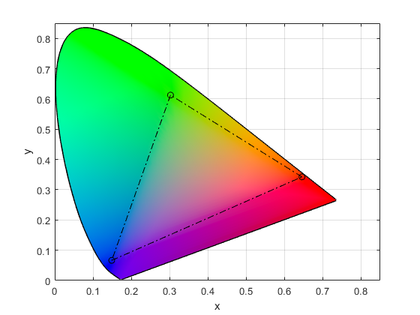
Gamut figure
Angle/Hue
White point (D65)
Eccentricity/Chroma
x
Max allowed Chroma, and the circle on which hue settings will be made
+
0 deg
Note this is shown in xy space by the principle is the same for LAB

Slide 8
Questionnaire (draft)
About your device:
What make is your phone?
What model is your phone?
Does your phone run on Android or Apple OS?
What browser do you use?
Do you use a “blue light filter” app or setting? Yes/No/Don’t know
-[If yes] Was the “blue light filter” switched on when you completed the task? Yes/No/Don’t know
What mode do you generally use your phone in? Dark mode / Light mode / Don’t know/other
Does your phone adjust brightness automatically?
Does your phone have TrueTone (iPhone) ?
How long have you had this phone for? (months)
Approximately how many hours per day do you spend using this phone?
About your surroundings:
Where are you currently? At home / on campus
-[on campus] What room are you in?
What is the lighting like where you are sitting? Completely natural, majority natural, majority artificial, completely artificial
Notes:
Yesesvi – make a questionnaire

